Slide 1

Practical New Developments in the BREACH Attack
Dimitris Karakostas
Dionysis Zindros

Slide 2
HTTPS is broken
BREACH broke HTTPS + RC4 in 2013
People upgraded to AES – thought they were safe
Today...
We show TLS + AES is still broken
HTTPS can be decrypted - quick and easy
We launch open source tool to do it here in Singapore

Slide 3
Overview
BREACH review
Our contributions
Statistical attacks
Attacking block ciphers
Attacking noise
Optimization techniques
Our tool: Rupture
Mitigation recommendations

Slide 4



Original BREACH research
Introduced in Black Hat USA 2013
Angelo Prado
Neal Harris
Yoel Gluck

Slide 5
BREACH attack anatomy

Slide 6
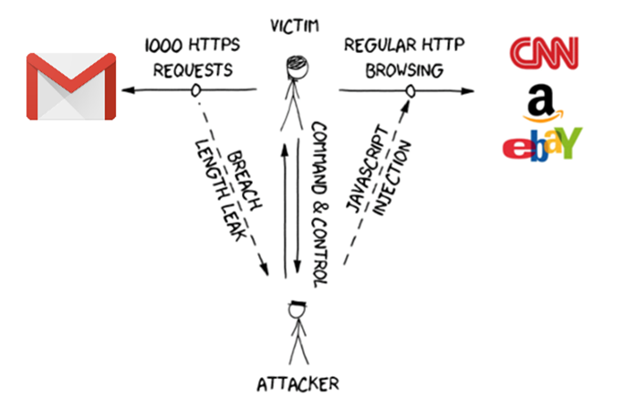

Slide 7
Original BREACH assumptions
Target website:
Uses HTTPS
Compresses response using gzip
Uses stream cipher
Response has zero noise
Contains end-point that reflects URL parameter

Slide 8
Original BREACH target
Steal secret in HTTPS response (CSRF tokens)
Use CSRF to impersonate victim client to victim server

Slide 9

Length leaks
|E(A)| < |E(B)| ⇔ |A| < |B|

Slide 10
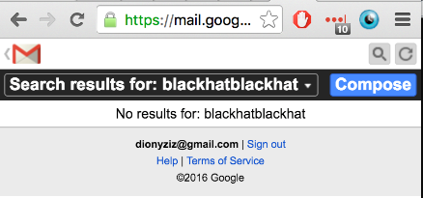
Let’s attack Gmail
m.gmail.com mobile Gmail view
Mobile search functionality uses HTTP POST – but HTTP GET still works :)
CSRF token included in response – valid for all of Gmail

Slide 11
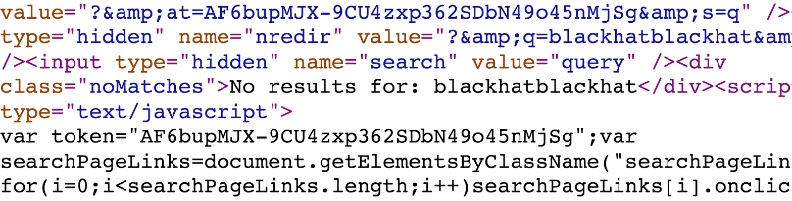
Noise
Reflection
Secret

Slide 12
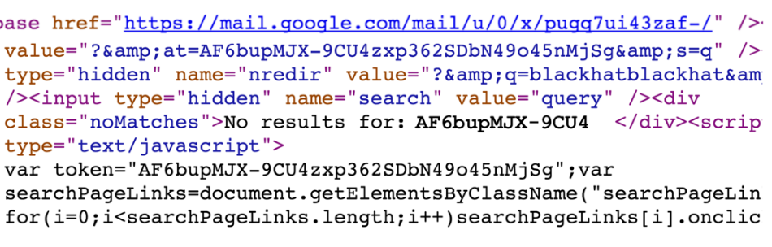
Attacker guesses part of secret
Uses it in reflection
Compressed/encrypted response is shorter if right!

Slide 13
Original BREACH methodology
Guess part of secret and insert into reflection
Match? → Shorter length due to compression
No match? → Longer length
Bootstrap by guessing 3-byte sequence
Extend one character at a time
O(n|Σ|) complexity
n: length of secret
Σ: alphabet of secret

Slide 14
Can we really attack Gmail?
Uses AES
Has random bytes in response

Slide 15
Our contributions

Slide 16
Our contributions
We extend the BREACH attack
Attack noisy end-points
Attack block cipher end-points
Optimize attack
Propose novel mitigation techniques
The whole web is vulnerable

Slide 17
Statistical methods

Slide 18
Statistical methods
We can attack noisy end-points
Multiple requests per alphabet symbol
Take mean response length
m-sized noise → attack works in O(n|Σ|√m)
m = (max response size) - (min response size)
Length converges to correct results (LLN)

Slide 19
Statistical methods against block ciphers
Everyone uses block ciphers
Statistical methods break them
We introduce artificial noise
Block ciphers round length to 128-bits
In practice 16x more requests
Blocks aligned → Length difference measurable

Slide 20
Experimental results
AES_128 is vulnerable
Popular web services are vulnerable:
Gmail
Facebook
etc.

Slide 21
Optimizations

Slide 22
Optimizations overview
Block ciphers cause 16x slowdown. We need to optimize.
Divide and conquer: 6x speed-up
Request soup: 16x speed-up
Browser parallelization: 6x speed-up
Total ~ 500x speed-up!

Slide 23
Optimization: Divide & Conquer
Each request tries multiple candidates from alphabet
Partition alphabet using divide-and-conquer
Binary search on alphabet partitions
Reduces attack complexity from O(n|Σ|) to O(n lg|Σ|)
Practically this gives 6x speed-up

Slide 24
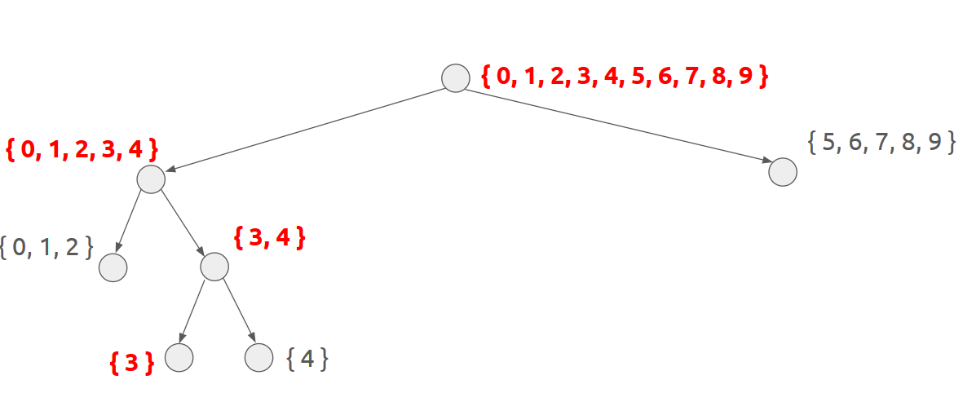
Binary search in alphabet space

Slide 25
Optimization: Request soup
Problem:
Need 16x samples for block ciphers
But we only need the length mean
Solution:
Responses come pipelined, can’t tell them apart
We don’t care! Measure total length
Divide by amount, extract mean

Slide 26
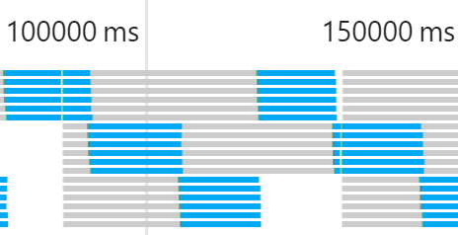
Optimization: Browser parallelization
Do 6x parallel requests; browsers support it
Each parallel request cannot adapt based on previous
But we need many samples of same candidates anyway
No need to adapt before we collect enough

Slide 27

RUPTURE

Slide 28
Today, we make BREACH easy
Over the past months, we’ve developed rupture
Today in Black Hat Asia 2016, we make it open source
https://github.com/dionyziz/rupture
ruptureit.com

Slide 29
Rupture
Extensible
Modular analysis / optimizations / strategies
Experiment with your own
General web attack framework
Can be adapted to work for CRIME, POODLE, …
Persistent command & control channel
Scalable architecture: Multiple attacks simultaneously
Come help us make it better

Slide 30
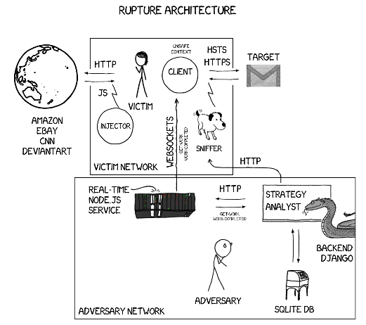

Slide 31
Robust, persistent command & control
Automatically inject JS to HTTP
All plaintext connections infected
One tab at a time gets work from C&C server
User closes tab? Different tab starts attacking
User switches browsers? Works on different browser
Data collection failed for a sample? Sample recollected
User reboots computer? Attack continues

Slide 32
Persistent attack data storage
Collected data processed by Django middleware
Attack historical data stored permanently in MySQL db
Future analysis with new techniques possible

Slide 33
Rupture demo

Slide 34
Mitigation

Slide 35
First-party cookies
Don’t send auth cookies cross-origin
Backwards compatibility: Web server opts-in
Mike West implemented it in Chrome 51
Coming April 8th
Set-Cookie: SID=31d4d96e407aad42; First-Party

Slide 36
Key takeaways
HTTPS + gzip = broken
Rupture framework is live – attacks are easy
Enable first-party cookies on your web app

Slide 37
Thank you! Questions?
twitter.com/dionyziz
45DC 00AE FDDF 5D5C B988 EC86 2DA4 50F3 AFB0 46C7
github.com/dimkarakostas
DF46 7AFF 3398 BB31 CEA7 1E77 F896 1969 A339 D2E9

